Slide 1
Introduction to Python
Python 3

Slide 2
Introduction to Python
Python is a high-level programming language
Open source and community driven
“Batteries Included”
  a standard distribution includes many modules
Dynamic typed
Source can be compiled or run just-in-time
Python is a interpreted language
Similar to perl, tcl, ruby, matlab etc

Slide 3
Why Python?
Nowadays, Python is one of the most popular programming languages worldwide according to the TIOBE index and the number of programmers who use it is growing every day.
The language has a huge community of developers around the world. If you have a problem, you can always ask other programmers for help or find a suitable answer on a site like stackoverflow.com
Python has a wide range of possible applications, especially in:
  web development
  data science (including machine learning)
  scripting (task automation, e.g. text processing or a simulation of typical user actions)
  Desktop App (object methodology )

Slide 4
Short history of Python
Like other programming languages, Python has gone through a number of versions. Python 1.0 was released in 1994 and laid the basic principles of the language with emphasis on simplicity.
Python 2.0 was released in 2000. This version has become very popular among programmers. Different 2.x subversions (2.6, 2.7) are still used in various projects and libraries. The symbol x in 2.x means any subversion of Python 2.
Python 3.0 was the next major version released in 2008. It broke backward compatibility with its predecessors in order to rid the language of historic clutter and make Python more readable and consistent.
So, today two similar but incompatible versions of Python are commonly in use. Throughout this, we will learn Python 3.x.

Slide 5
Python Interfaces
IDLE – a cross-platform Python development environment
PythonWin – a Windows only interface to Python
Python Shell – running 'python' from the Command Line opens this interactive shell
For the exercises, we'll use IDLE, but you can try them all and pick a favorite

Slide 6
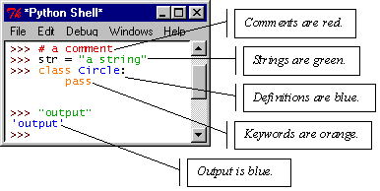
IDLE – Development Environment
IDLE helps you program in Python by:
  color-coding your program code
  debugging
  auto-indent
  interactive shell

Slide 7
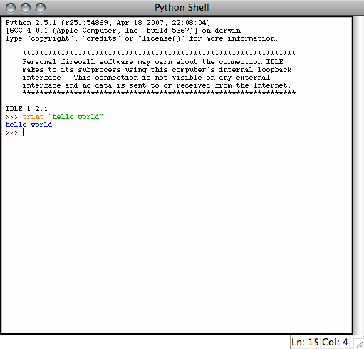
Example Python
Hello World
  print(“hello world”)
Prints hello world to standard out
Open IDLE and try it out yourself
Follow along using IDLE

Slide 8
More than just printing
Python is an object oriented language
Practically everything can be treated as an object
“hello world” is a string
Strings, as objects, have methods that return the result of a function on the string

Slide 9
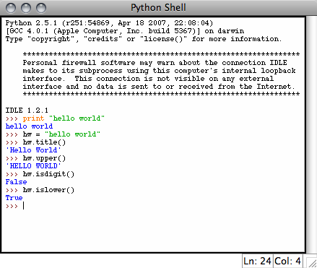
String Methods
Assign a string to a variable
In this case “hw”
hw.title()
hw.upper()
hw.isdigit()
hw.islower()

Slide 10
String Methods
The string held in your variable remains the same
The method returns an altered string
Changing the variable requires reassignment
  hw = hw.upper()
  hw now equals “HELLO WORLD”

Slide 11
Other Python Objects
Lists (mutable sets of strings)
  var = [] # create list
  var = [‘one’, 2, ‘three’, ‘banana’]
Tuples (immutable sets)
  var = (‘one’, 2, ‘three’, ‘banana’)
Dictionaries (associative arrays or ‘hashes’)
  var = {} # create dictionary
  var = {‘lat’: 40.20547, ‘lon’: -74.76322}
  var[‘lat’] = 40.2054
Each has its own set of methods

Slide 12
Lists
Think of a list as a stack of cards, on which your information is written
The information stays in the order you place it in until you modify that order
Methods return a string or subset of the list or modify the list to add or remove components
Written as var[index], index refers to order within set (think card number, starting at 0)
You can step through lists as part of a loop

Slide 13
List Methods
Adding to the List
  var[n] = object
    replaces n with object
  var.append(object)
    adds object to the end of the list
Removing from the List
  var[n] = []
    empties contents of card, but preserves order
  var.remove(n)
    removes card at n
  var.pop(n)
    removes n and returns its value

Slide 14
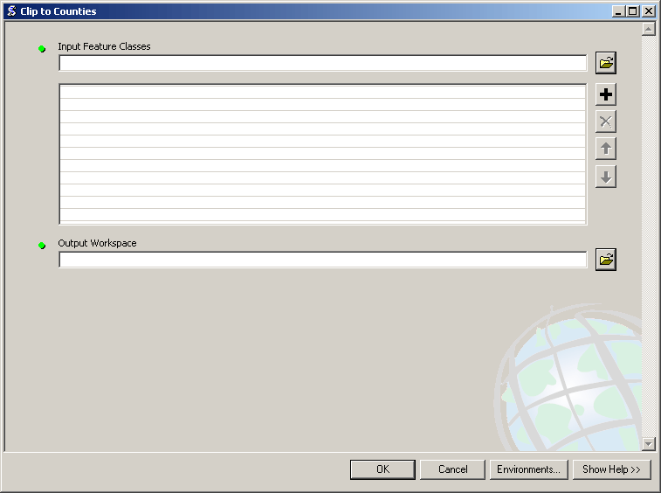
Lists in ArcToolbox
You will create lists:
Layers as inputs
Attributes to match
Arrays of objects
You will work with lists:
List of field names
List of selected features

Slide 15
Tuples
Like a list, tuples are iterable arrays of objects
Tuples are immutable –
once created, unchangeable
To add or remove items, you must redeclare
Example uses of tuples
  County Names
  Land Use Codes
  Ordered set of functions

Slide 16
Dictionaries
Dictionaries are sets of key & value pairs
Allows you to identify values by a descriptive name instead of order in a list
Keys are unordered unless explicitly sorted
Keys are unique:
  var[‘item’] = “apple”
  var[‘item’] = “banana”
  print var[‘item’] prints just banana

Slide 17
Indentation and Blocks
Python uses whitespace and indents to denote blocks of code
Lines of code that begin a block end in a colon:
Lines within the code block are indented at the same level
To end a code block, remove the indentation
You'll want blocks of code that run only when certain conditions are met

Slide 18
Conditional Branching
if and else
  if variable == condition:
  #do something based on v == c
  else:
  #do something based on v != c
elif allows for additional branching
  if condition:
  elif another condition:
  …
  else: #none of the above

Slide 19
Looping with For
For allows you to loop over a block of code a set number of times
For is great for manipulating lists:
a = ['cat', 'window', 'defenestrate']
for x in a:
print x, len(x)
Results:
  cat 3
  window 6
  defenestrate 12

Slide 20
Looping with For
We could use a for loop to perform geoprocessing tasks on each layer in a list
We could get a list of features in a feature class and loop over each, checking attributes
Anything in a sequence or list can be used in a For loop
Just be sure not to modify the list while looping

Slide 21
Modules
Modules are additional pieces of code that further extend Python’s functionality
A module typically has a specific function
  additional math functions, databases, network…
Python comes with many useful modules
arcgisscripting is the module we will use to load ArcGIS toolbox functions into Python

Slide 22
Modules
Modules are accessed using import
  import sys, os # imports two modules
Modules can have subsets of functions
  os.path is a subset within os
Modules are then addressed by modulename.function()
  sys.argv # list of arguments
  filename = os.path.splitext("points.txt")
  filename[1] # equals ".txt"

Slide 23
Files
Files are manipulated by creating a file object
  f = open("points.txt", "r")
The file object then has new methods
  print f.readline() # prints line from file
Files can be accessed to read or write
  f = open("output.txt", "w")
  f.write("Important Output!")
Files are iterable objects, like lists

Slide 24
Error Capture
Check for type assignment errors, items not in a list, etc.
Try & Except
  try:
  a block of code that might have an error
  except:
  code to execute if an error occurs in "try"
Allows for graceful failure
– important in ArcGIS

Slide 25
Additional Python Resources
Python Homepage
http://www.python.org/
Dive Into Python
http://www.diveintopython.org/
Learning Python, 3rd Edition
http://www.oreilly.com/catalog/9780596513986/
Getting Started Writing Geoprocessing Scripts
Available on ESRI's support page

